Slide 1
Wallace Tree Multiplier
CA INNOVATIVE ASSIGNMENT

Slide 2
Definition
The Wallace tree multiplier is a digital circuit used for multiplying two binary numbers. It was invented by Chris Wallace in the 1960s and has been widely used in many applications that require fast multiplication, such as digital signal processing, graphics processing, and cryptography.

Slide 3
Difference between Wallace tree multiplier and Traditional multiplier circuit
In a traditional multiplier circuit, each bit of one of the numbers is multiplied by each bit of the other number, resulting in a large number of partial products that need to be added together to get the final product. This process can be time-consuming and require a large number of adders, which can limit the speed and efficiency of the multiplication process.
The Wallace tree multiplier reduces the number of partial products by grouping them into groups of three and adding them together using half adders and full adders. These groups are then combined into larger groups of three and added together again, until only two groups remain. These two final groups are then added together to get the final product.

Slide 4
ADVANTAGES
01
02
03
04
05
06
High-speed multiplication
Scalability
Efficient hardware utilization
Lower latency
Reduced power consumption
High accuracy

Slide 5

Disadvantages
01
02
03
04
Complexity
Large chip area
Pipelining
Limited precision

Slide 6
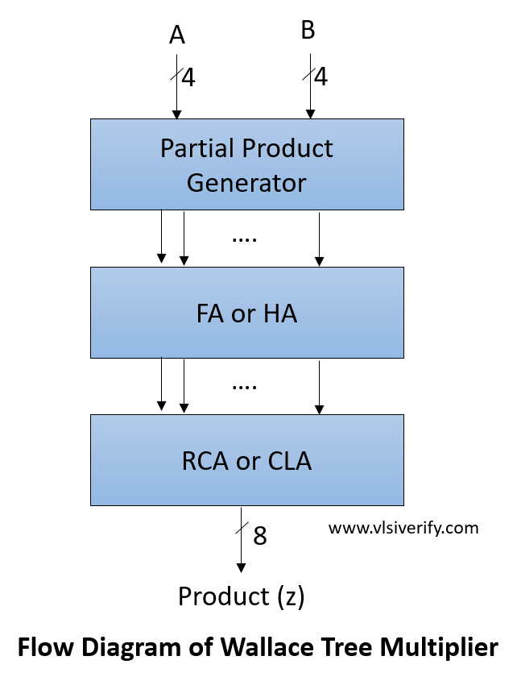
FLOW DIAGRAM WTM

Slide 7

Design Blocks
The partial product generator generates partial products using a simple two-input AND gate that is fed to the Wallace tree adder.
Multiple half and a full adders that does additions in multiple levels and also considers carry generated by a previous level adder.
The last level of the Wallace tree adder can be implemented ripple carry adder. However, to improve computation latency, a carry look-ahead adder can also be used.

Slide 8
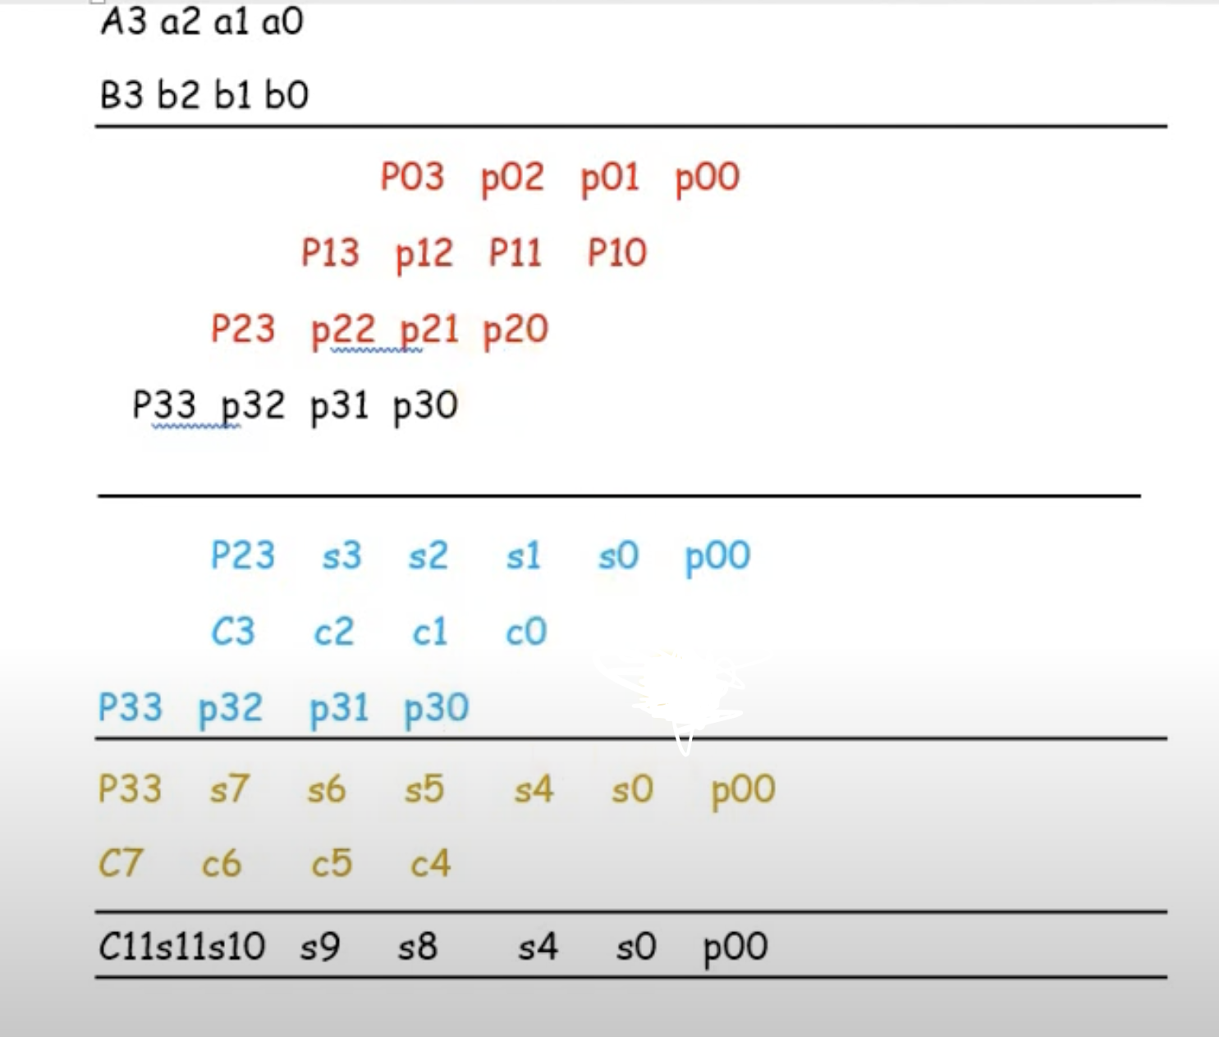
Example of 4 bit

Slide 9
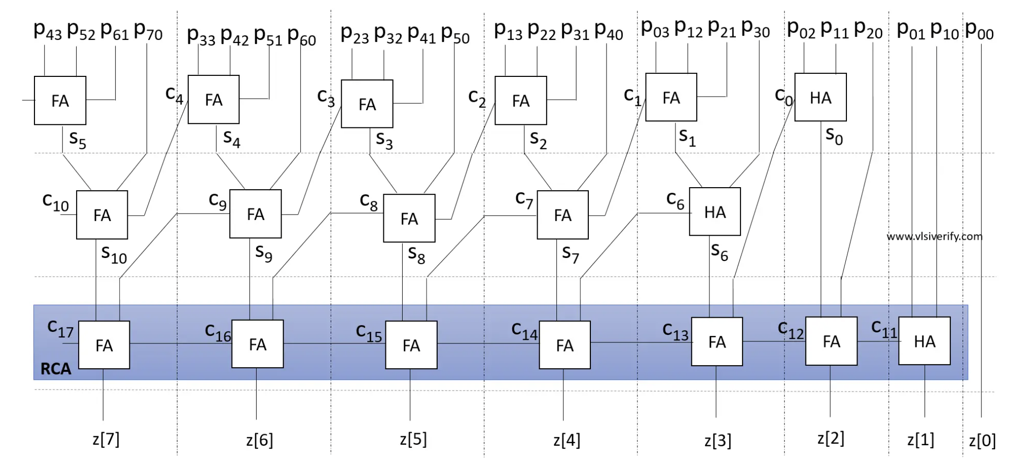
Block Diagram

Slide 10
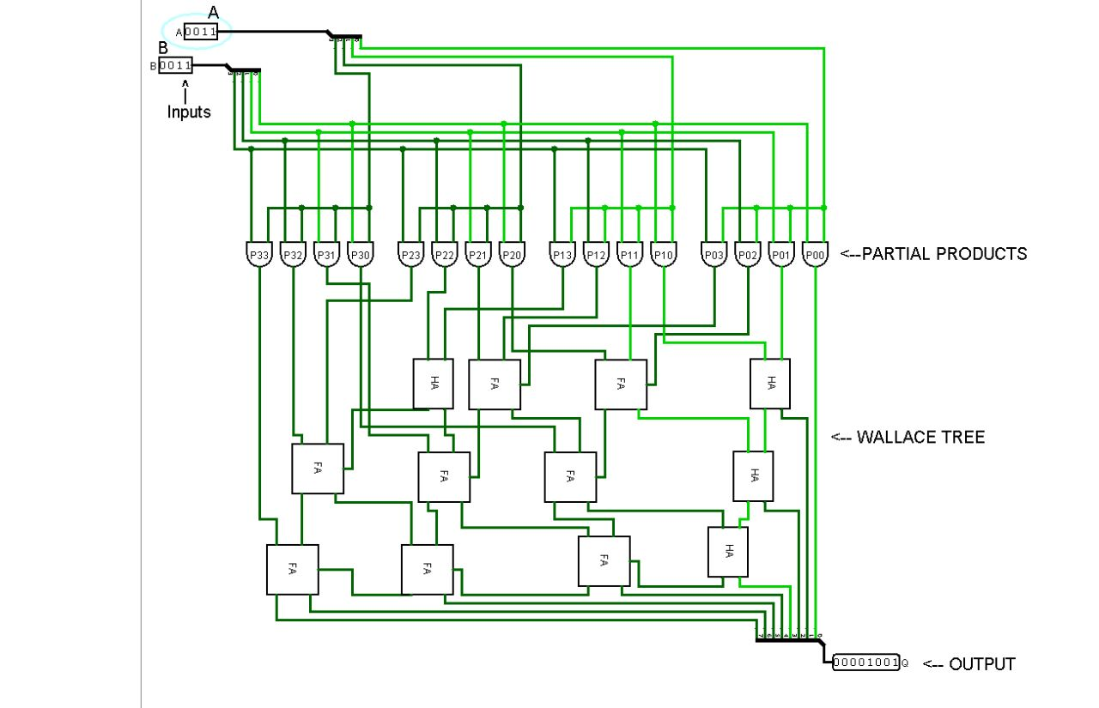
Logisim Circuit

Slide 11
Steps to be followed
Partitioning: The two n-bit input operands A and B are partitioned into overlapping groups of smaller k-bit segments. The last segment of each operand may contain fewer than k bits.
Encoding: Each k-bit segment of A and B is encoded into a set of partial products using a set of AND gates. For example, the jth bit of segment i of A and B is multiplied to form the (i+j-1)th partial product.
Reduction: The partial products are then reduced using a combination of carry-save adders and carry-propagate adders. The first stage of the reduction is performed using carry-save adders, which generate two output bits: a sum bit and a carry bit. The carry bits are saved for the next stage of the reduction.
Final addition: The final stage of the reduction is performed using carry-propagate adders, which propagate the saved carry bits through the partial products to generate the final product.
Output: The final product is then output as an n-bit binary number.

Slide 12
CONCLUSION
Overall, the Wallace tree multiplier offers high-speed multiplication, scalability, efficient hardware utilization, lower latency, reduced power consumption, and high accuracy, making it a popular choice in many digital circuit designs. However, it's worth noting that the optimal choice of multiplier depends on the specific requirements and constraints of the target application, and other types of multipliers may be more suitable in certain scenarios

Slide 13
Thank You
21BCE194 HET
21BCE210 NEMI
21BCE232 RUSHIL
21BCE244 FENIL

